Slide 1

P peline
The Data
Human Centered Issues in Data Acquisition
© Jennifer Mankoff & Nikola Banovic
The Data Pipeline; HCII; Spring 2017

Slide 2
Goals
After this, you should be able to:
Understand the key components of the data pipeline
Have a sense of what material this course does and does not cover
Know about the work expectations in the course
Have information about how to start collecting your own data from your phone
Adapted from http://www.fordham.edu/economics/Vinod/correl-regr.ppt

Slide 3
Stay in the room if you want to
Learn about problems with data collection, use and interpretation
Learn about techniques for visualizing and interpretation of data
Explore applied examples of data use
Explore the end user experience of data
Develop a portfolio of data-driven applications
Collect your own data and analyze it
Notes:
Close your laptop and phone please

Slide 4
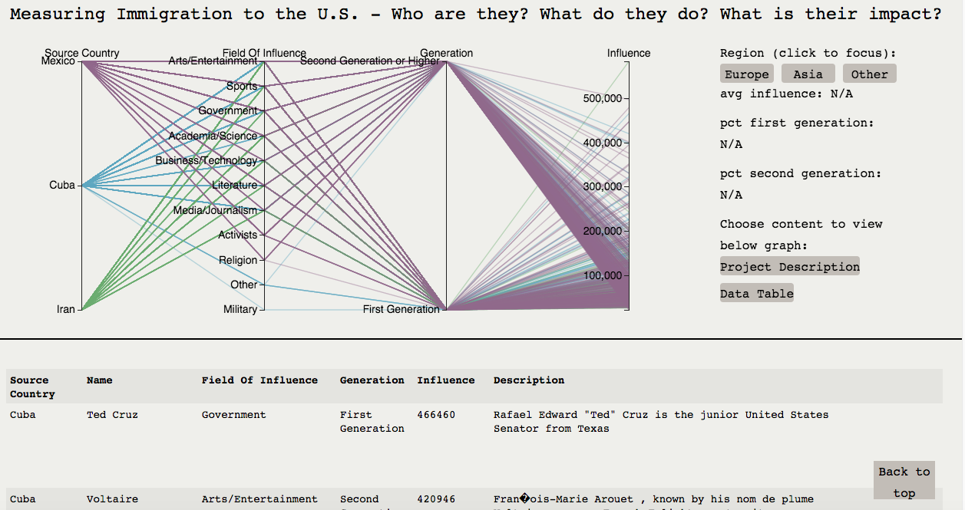
Some examples: Influential Immigrants
http://root-arcanum-92800.appspot.com/

Slide 5
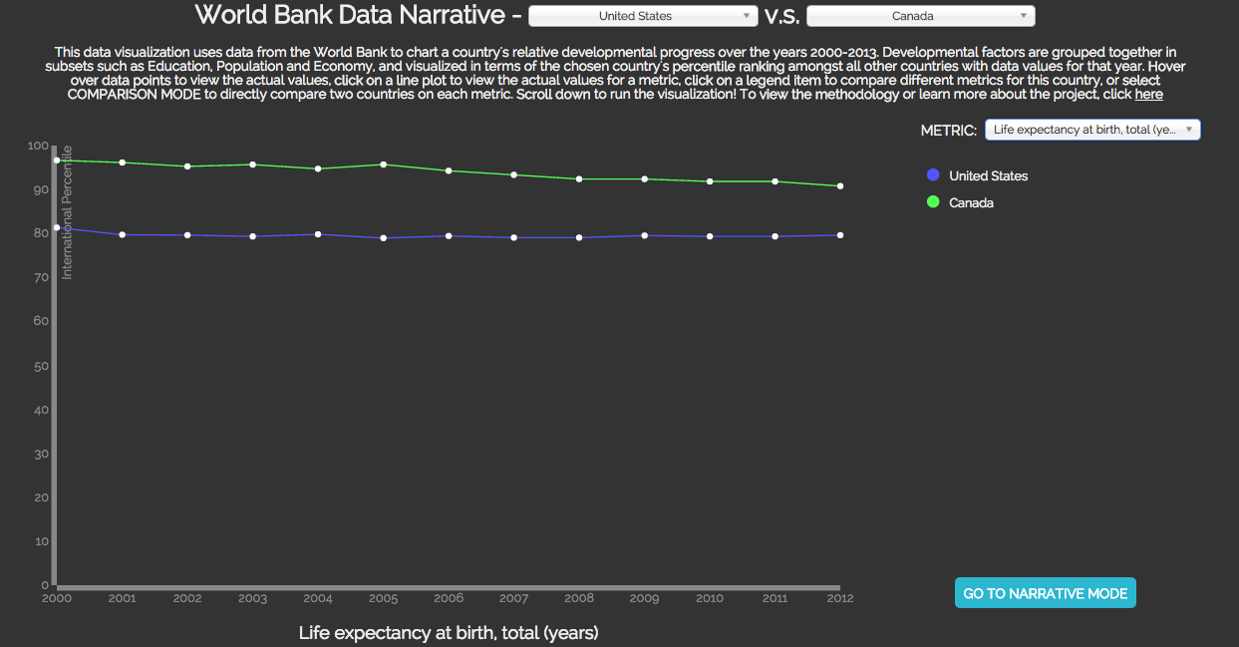
Some examples: Development Progress
http://iamohcy.com/worldbankvisualization/

Slide 6
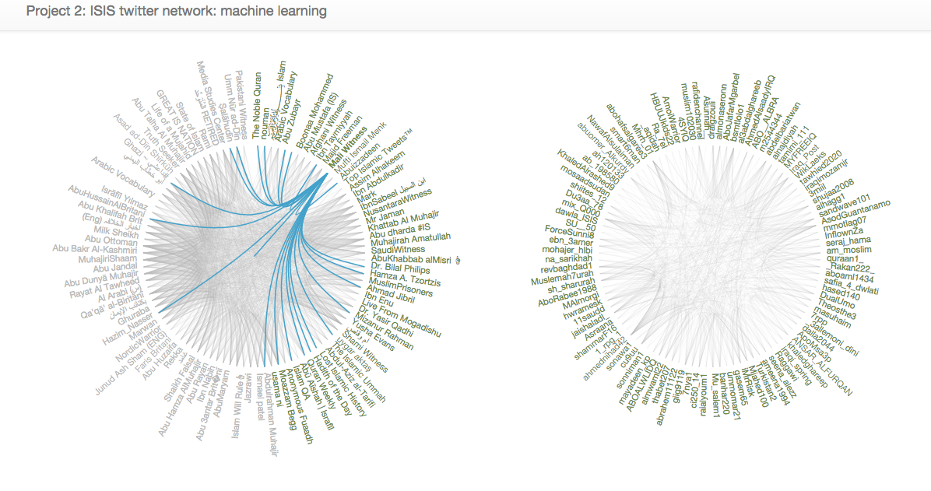
Some examples: Fighting ISIS
http://project2-isistweet.appspot.com/

Slide 7
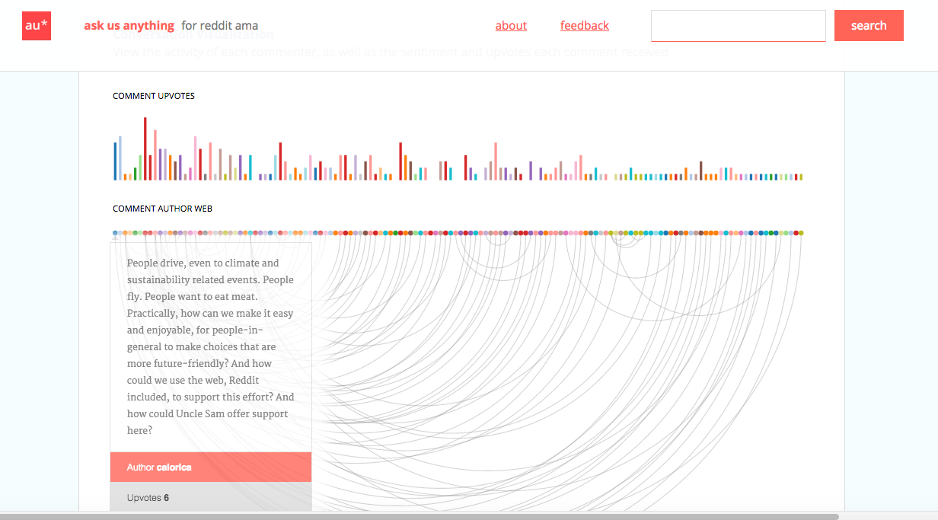
Some examples: Reddit AMA
http://askusanything.cc/thread?id=40e1jk

Slide 8
What’s your profile?
Fill out: http://data.cmubi.org/classroom-news/2017studentpoll

Slide 9
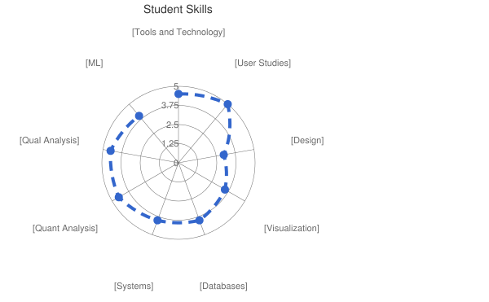
Jen+Nikola Profile

Slide 10
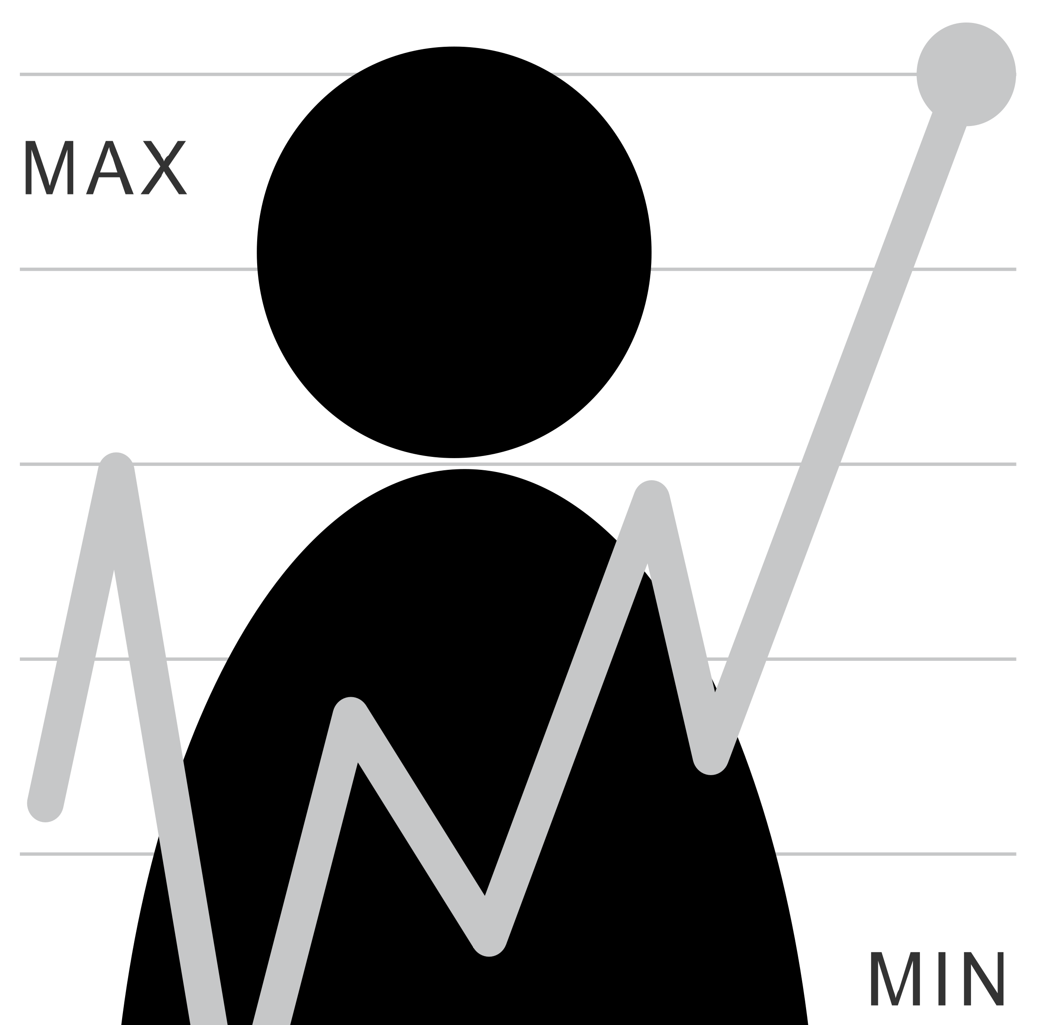
What is the Data Pipeline?
How much do I exercise?
What kind of question is this? Is it a good or a bad one? Can we rephrase it?
What sort of data could help answer it? What would a user need to do to collect good quality data? What would they do with the data?
Question
Is it the right question?
Collect Data
Is it the right data for the question?
How hard/easy is it to collect?
Is it answerable?
Stats/Graphs/ML
Intuition
Explore Data

Slide 11
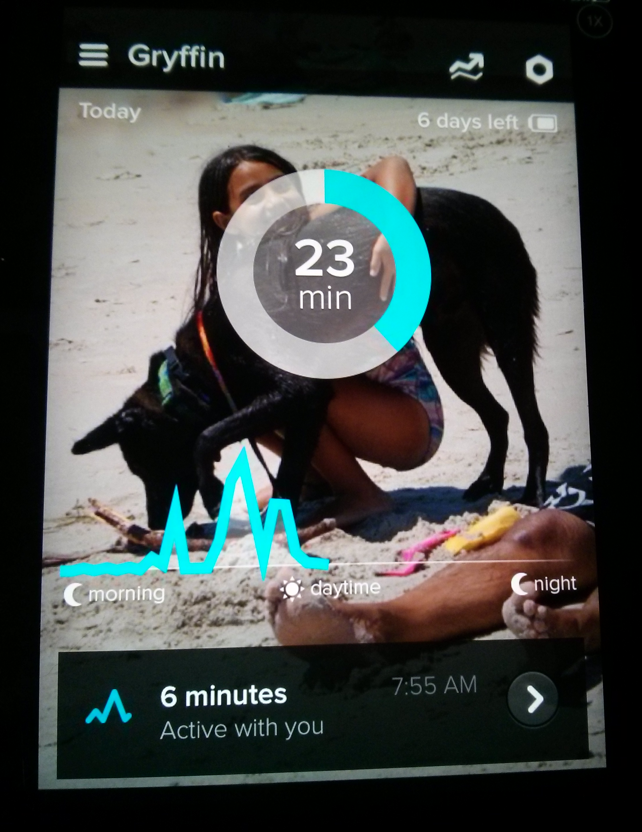
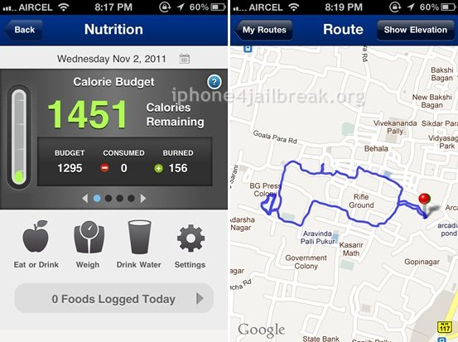
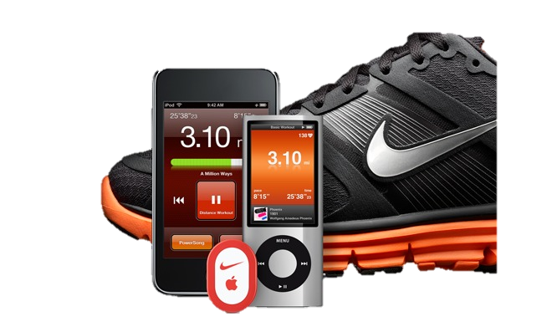
Example: Mobile data collection; Identifying activity

Slide 12
What is the Data Pipeline?
Question
Is it the right question?
Collect Data
Is it the right data for the question?
How hard/easy is it to collect?
Is it answerable?
Stats/Graphs/ML
Intuition
Explore Data

Slide 13
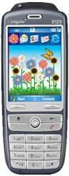
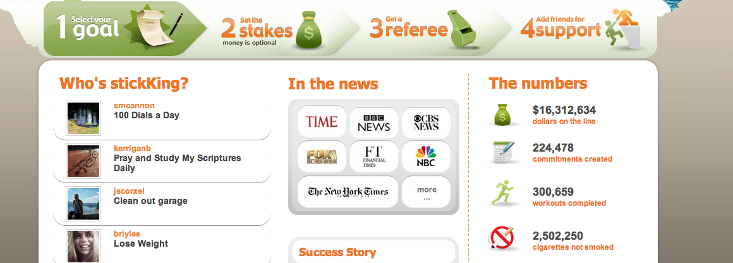
It’s not all about data…

Slide 14
It’s not all about data…
… and even if it was …

Slide 15
What is the Data Pipeline?
Question
Is it the right question?
Collect Data
Is it the right data for the question?
How hard/easy is it to collect?
Clean Data
What flaws exist in the data?
How do we address them?
Is it answerable?
Explore Data
Stats/Graphs/ML
Intuition

Slide 16
Can you trust your data?
Just because you have a lot of data, does not mean that it is good data The plural of “anecdote” is not “data”.
Content borrowed from Bill Thies

Slide 17
Four C’s of Data Quality
Is your data Complete?
Is your data Coherent?
Is your data Correct?
Is your data aCcountable?

Slide 18
What is the Data Pipeline?
Question
Is it the right question?
Collect Data
Is it the right data for the question?
How hard/easy is it to collect?
Clean Data
What flaws exist in the data?
How do we address them?
Is it answerable?
Explore Data
Stats/Graphs/ML
Intuition

Slide 19
Unlike laboratory data,
real world data is not easily segmented by task
Notes:
Analyzing real world data is more complicated than analyzing laboratory data. One reason is that laboratory log data is typically “segmented” by task (or intent) which is usually clear because the experimenter tells the participant what to do. However, when studying real world data, we do not know the user’s tasks and the only information we have to work with are long logs of event data.
Since we don’t know intent, we segment data according to events captured by CRUMBS that are relevant to the assessments we want to make. In this thesis we focus on targeting motions, so we segment data by button events and pauses.

Slide 20
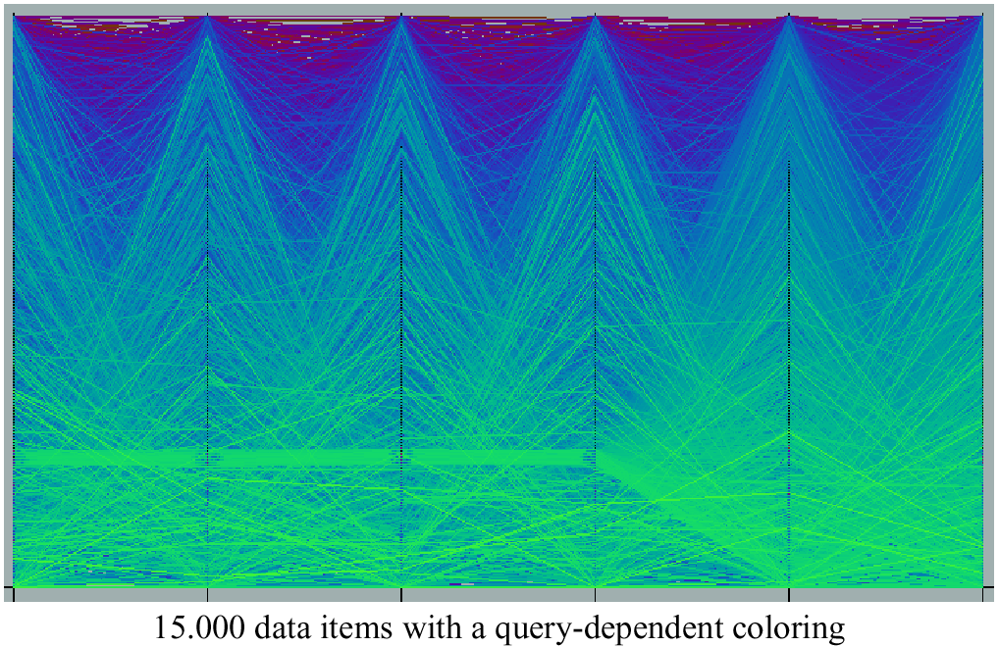
Query Dependent Coloring

Slide 21
Characterizing Performance: Slipping
Notes:
User unintentionally moves cursor while button is pressed [Trewin et al. 2006]

Slide 22
What is the Data Pipeline?
Question
Is it the right question?
Collect Data
Is it the right data for the question?
How hard/easy is it to collect?
Clean Data
What flaws exist in the data?
How do we address them?
Is it answerable?
Explore Data
Stats/Graphs/ML
Use data
Communicate/Predict/…
Intuition

Slide 23
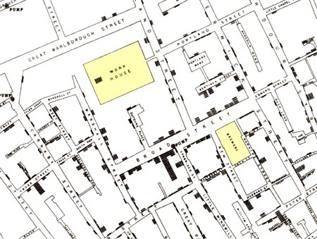
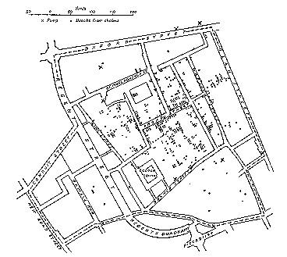
Success – user learned something
Illustration of John Snow’s
deduction that a cholera epidemic
was caused by a bad water pump, circa 1854.
Horizontal lines indicate location of deaths.
From Visual Explanations by Edward Tufte, Graphics Press, 1997
Notes:
This map was actually made POST discovery (he used interviews to identify the problem first). What does this tell you about where intuition comes from?...

Slide 24
A full data pipeline
Question
Is it the right question?
Collect Data
Is it the right data for the question?
How hard/easy is it to collect?
Clean Data
What flaws exist in the data?
How do we address them?
Is it answerable?
Explore Data
Intuition
Use data
Communicate/Predict/…
Stats/Graphs/ML
Report on Findings
Visualize

Slide 25
Where are end users implicated?
Question
Is it the right question?
Collect Data
Is it the right data for the question?
How hard/easy is it to collect?
Clean Data
What flaws exist in the data?
How do we address them?
Is it answerable?
Explore Data
Intuition
Use data
Communicate/Predict/…
Stats/Graphs/ML
Report on Findings
Visualize

Slide 26
Where are end users implicated?
Question
Is it the right question?
Collect Data
Is it the right data for the question?
How hard/easy is it to collect?
Clean Data
What flaws exist in the data?
How do we address them?
Is it answerable?
Explore Data
Intuition
Use data
Communicate/Predict/…
Stats/Graphs/ML
Report on Findings
Visualize

Slide 27
Where are end users implicated?
Question
Is it the right question?
Collect Data
Is it the right data for the question?
How hard/easy is it to collect?
Clean Data
What flaws exist in the data?
How do we address them?
Is it answerable?
Explore Data
Intuition
Use data
Communicate/Predict/…
Stats/Graphs/ML
Report on Findings
Visualize

Slide 28
Where are end users (and HCI) implicated?
Question
Is it the right question?
Collect Data
Is it the right data for the question?
How hard/easy is it to collect?
Clean Data
What flaws exist in the data?
How do we address them?
Is it answerable?
Explore Data
Intuition
Use data
Communicate/Predict/…
Stats/Graphs/ML
Report on Findings
Visualize

Slide 29
Administrata
Your Instructors:
Jen Mankoff
Nikola Banovic

Slide 30
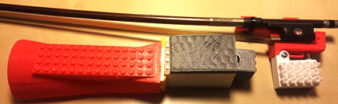
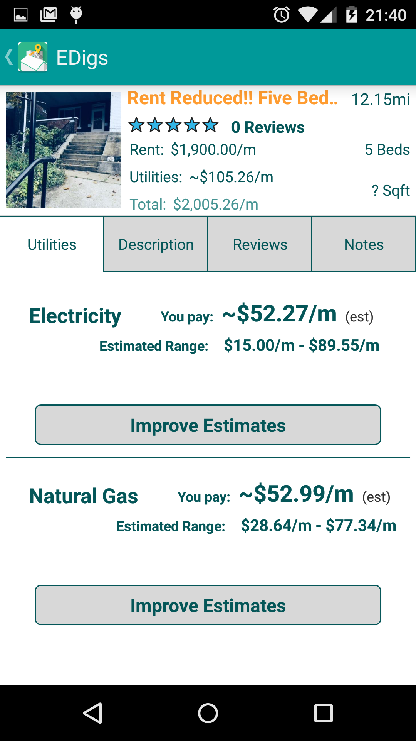

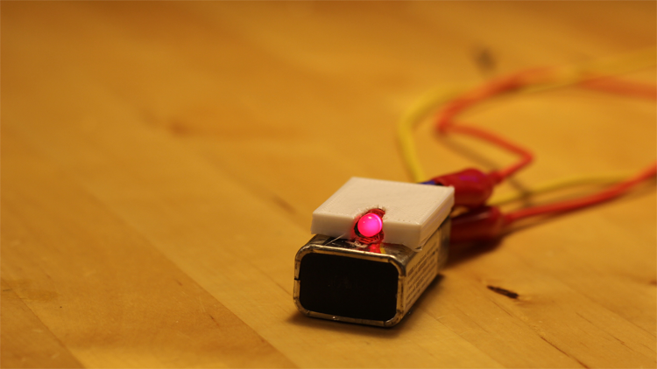
Jen Mankoff
At HCII since 2004
Research
Addressing critical social problems
Housing – Predicting utilities
Sustainability & Citizen Science – Qualitative data collection & analysis
Online tools for supporting health information seekers
Creating accessible new mobile, desktop, and web technologies
Developing enabling tools and processes
Fabrication & Applied Machine Learning
Teaching
Computer Science Perspectives in HCI
Process and Theory
Assistive Technology
Data Pipeline
Software Structures for UI
Background
Ph.D., Computer Science, Georgia Institute of Technology, 2001
B.A., Computer Science, Oberlin College, 1995

Slide 31
Where to find Jen
Newell Simon Hall 3615
Office Hours: 10:30 Thursdays
10am Fridays
By appointment
Schedule: data.cmubi.org/calendar
Email: jmankoff@cs.cmu.edu

Slide 32
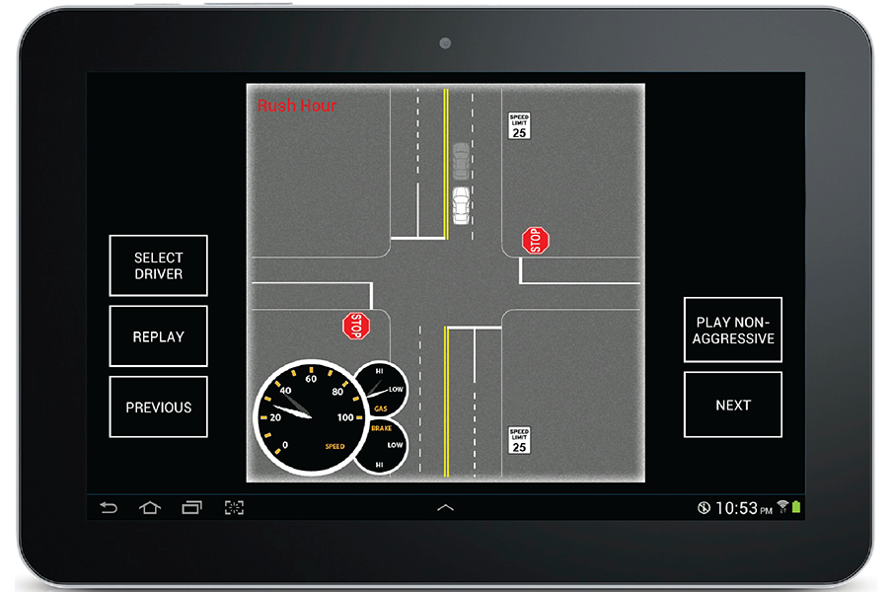
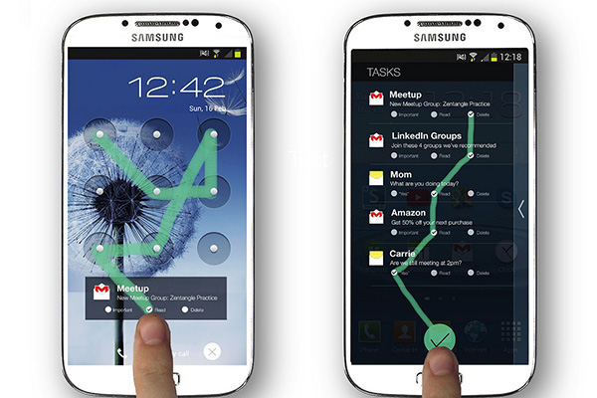
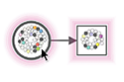

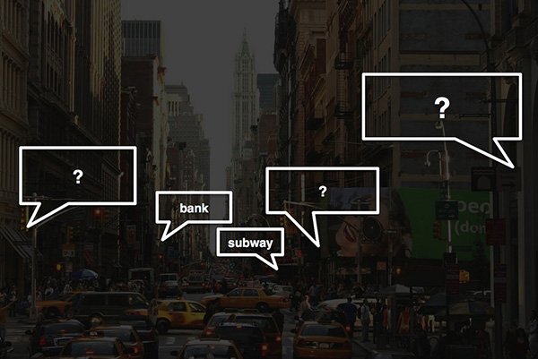
Nikola Banovic
At HCII since 2012
Research
Human Data Driven Interfaces
Modeling Human Behavior
Models of Routine Behavior
Low-level Interaction Models (pointing, text-entry)
Assistive Technologies (for people who are visually impaired)
Teaching
UCRE (TA)
Software Structures for UI (TA)
Data Pipeline
Background
M.S., Computer Science, University of Toronto, 2012
B.S., Computer Science, University of Toronto, 2010

Slide 33
Where to find NIkola
Newell Simon Hall 2502c
Office Hours: 2:30PM Tuesdays & Wednesdays
By appointment
Schedule: data.cmubi.org/calendar
Email: nbanovic@cs.cmu.edu

Slide 34
Administrata
Your Instructors: Jen & Nikola
Class Participation: No Phones or Laptops
Why? “students who multitask on laptops in class distract not just themselves but also their peers” http://www.sciencedirect.com/science/article/pii/S0360131512002254#
Reading assignments: two edits to piazza on day before each reading is due

Slide 35
Administrata
Your Instructors: Jen & Nikola Class Participation: No Phones or Laptops
Several small “Byte” sized exercises
Stepping stones to larger projects
Peer graded
Individual work
Tutorials and some sample code provided
First one due Monday

Slide 36
Byte1 (Due in a week)
Ask a question using fusion tables [swap decks]
Notes:
Let’s look in more depth… (swap decks)

Slide 37
Byte 2 (2 weeks)
Make an interactive website
Conducting exploratory data analysis
Emphasis on data quality
Skills: oauth; ajax
Some examples from last year (but no ajax)
http://data.cmubi.org/classroom-news/byte2exploreresults

Slide 38
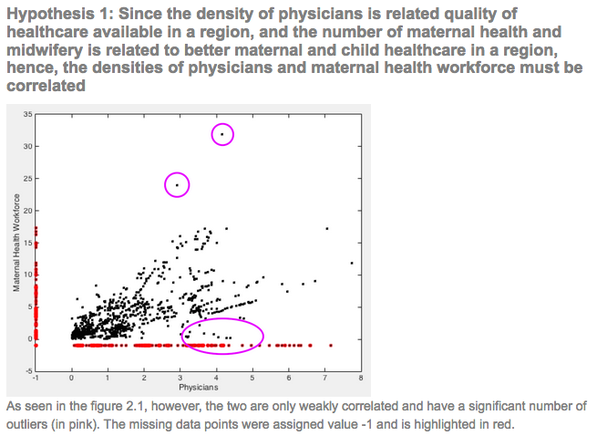
Example analysis of data quality
http://tvmayirp-fusion-byte2.appspot.com/quality

Slide 39
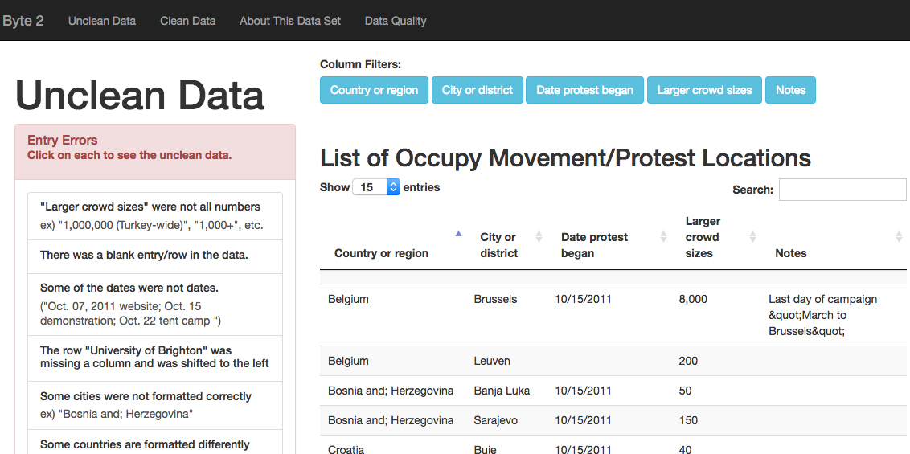
http://rahuang-byte-2.appspot.com/

Slide 40
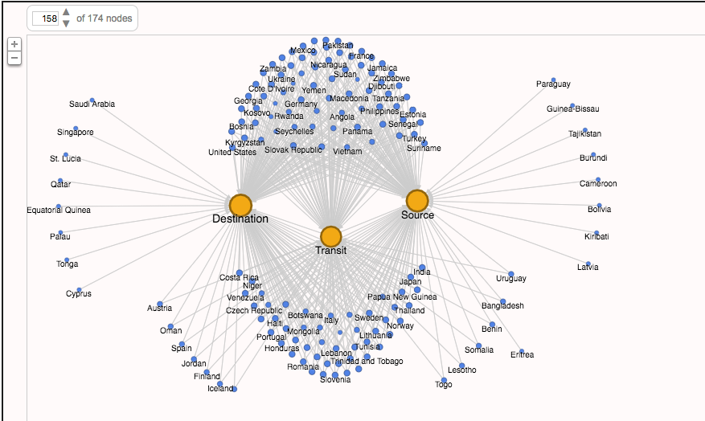
Visualization of human trafficking

Slide 41
Live exploration

Slide 42
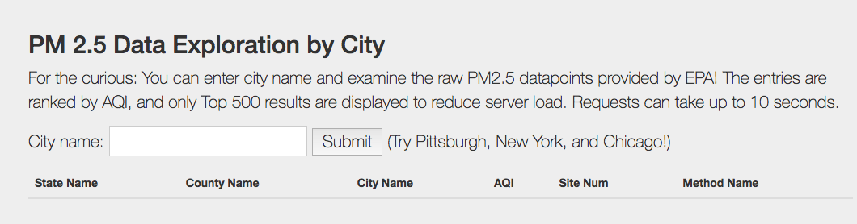
Live Exploration
Lung Cancer Data by City
http://yimmy-explore.appspot.com/

Slide 43
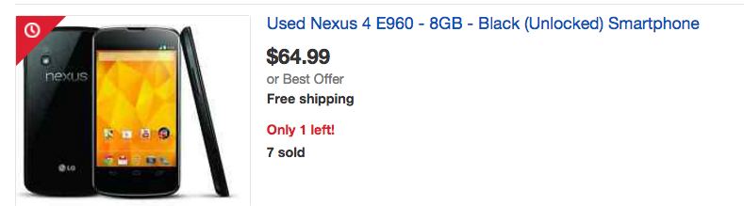
Byte 3 (2 weeks)
Your own data; custom visualization
INSTALL DUE TUESDAY
REQUIRED HARDWARE: Android or iPhone

Slide 44
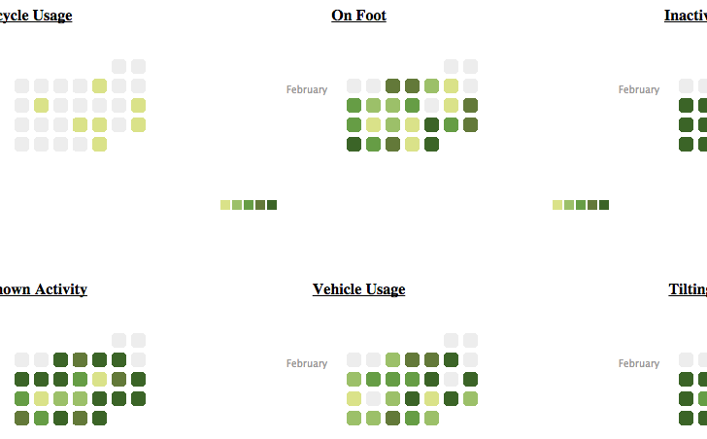
Activities by Time

Slide 45
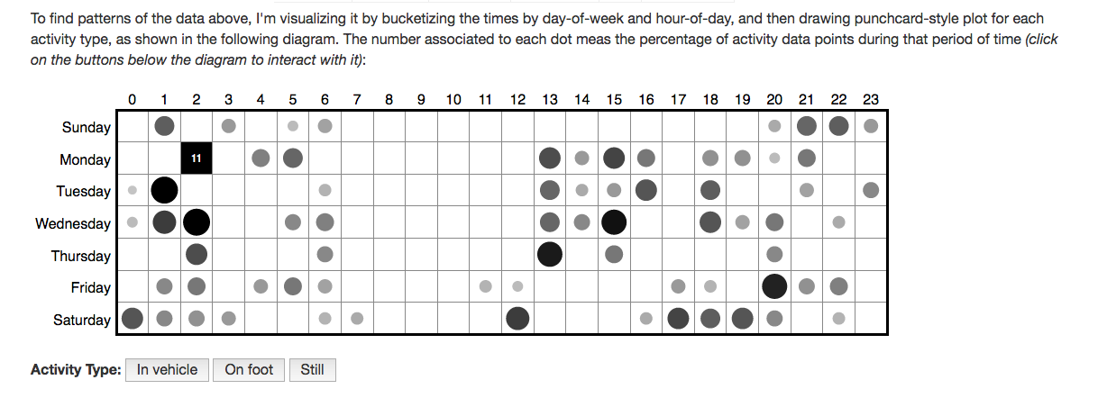
Custom Interactive Viz: Mobility by Time and Day
http://yimmy-mobile.appspot.com/

Slide 46
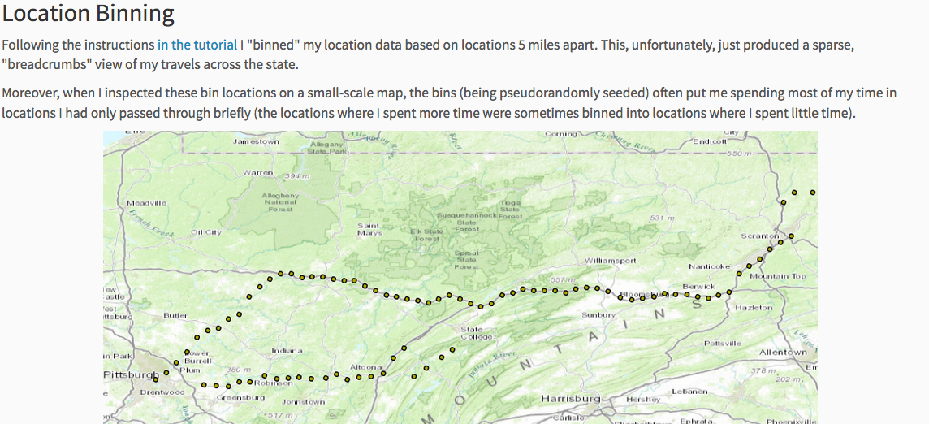
Location Binning
http://mark-where-and-what.appspot.com/

Slide 47
Information Visualization Project (2.5 weeks)
Open ended project you define
Develop a data visualization that tells a story about a data set of your choice
Iterative design of visualization
Group work allowed

Slide 48
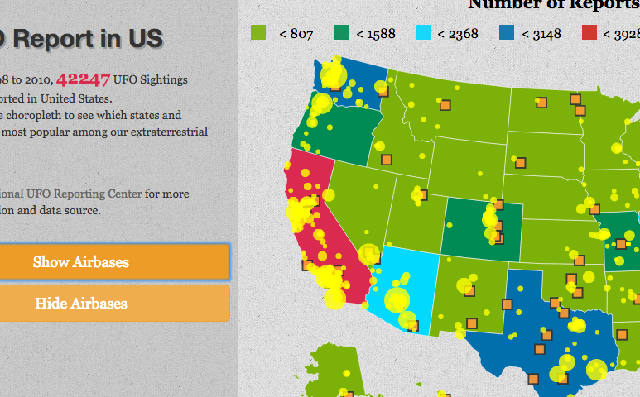
Example: jianf-proj1.appspot.com

Slide 49
Byte 4 (Machine learning with large data sets)
2 weeks
Well defined practice task involving machine learning
Integrate results into an interactive setting

Slide 50
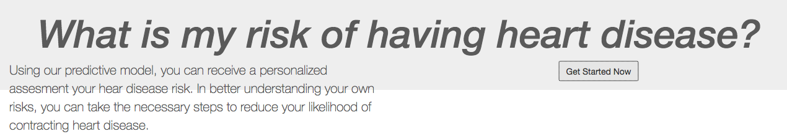
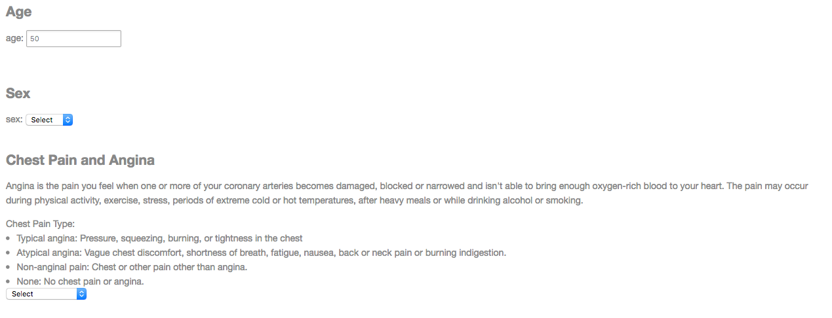
Heart Disease Prediction
http://heartdiseaseanalysis-268.appspot.com/form
…

Slide 51
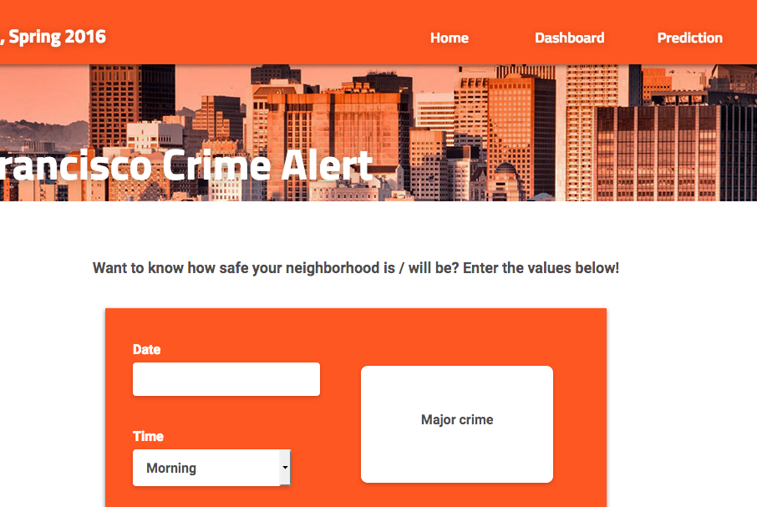
Crime
http://crimealert-1266.appspot.com/pred

Slide 52
Administrata
Class Participation: No Phones or Laptops
Participation in Balanced Campus Study
Several small “Byte” sized exercises
One larger project
Very self-defined
May be done in groups
Peer graded with instructor feedback

Slide 53
Final Project:
Goal: Develop an experience with providing interactive access to data
Select an audience
Select data that is effective for your goals
Iterate with People
Document your data
You may work in groups on this project

Slide 54
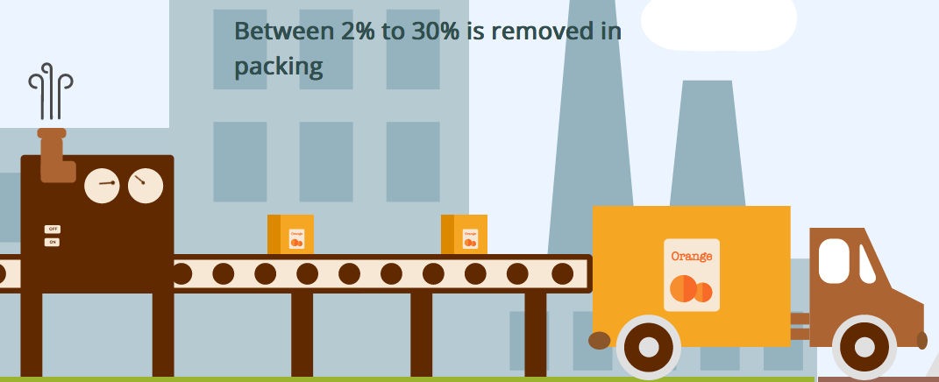
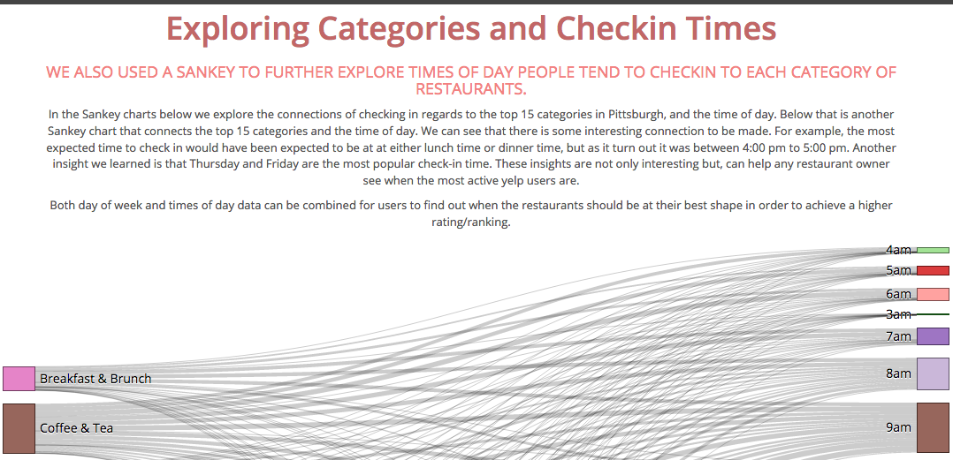
Final Projects – group; 5 weeks ++
http://food-data-exploration.appspot.com/story
http://bon-yinzers.appspot.com/

Slide 55
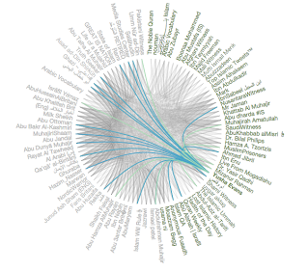
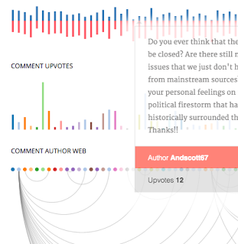
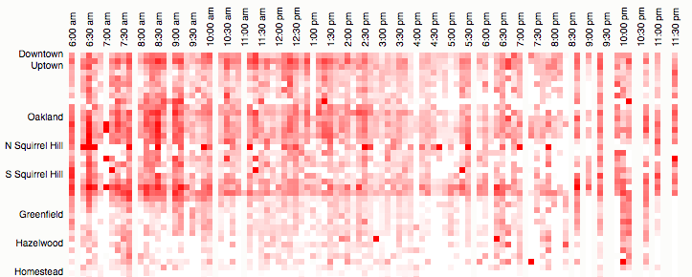
Final Projects – group; 5 weeks ++
Ises Discovery on Twitter
http://project2-isistweet.appspot.com/
Reddit AMA Viz
http://bunching.github.io/

Slide 56
Administrata
Class Participation: No Phones or Laptops
Participation in Balanced Campus Study
Several small “Byte” sized exercises
One larger projects
Weekly quizzes (extra credit)
Quizzes small and unannounced
Final exam

Slide 57
Grading
10% Class Participation
40% Project Bytes [peer graded]
40% Full Projects (midterm + final)
10% Final Exam

Slide 58
Pre-requisites
Aim to engage a range of programming abilities (primarily using python)
Comfort with programming and debugging important
Byte 1+2 (first assignment) will help you judge: due quickly for this reason
We assume no background in machine learning, databases, or statistics.

Slide 59
Other details
Large class, small staff (just Nikola + I)
Hence, requirement for peer grading
Peer grades due 2 days after assignment
Penalty for not grading

Slide 60


Recommended Texts

Slide 61



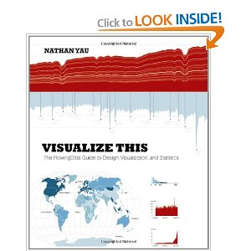

More books to consider

Slide 62
Where to find the class
Data.cmubi.org
https://github.com/jmankoff/data/
https://piazza.com/cmu/spring2017/05839/home
Note: Version control is your friend!!! You should consider joining github now, you will be required to use it for the bigger projects.

